Slide 1
Data Analysis for Users
Ritvik Dhupkar

Slide 2
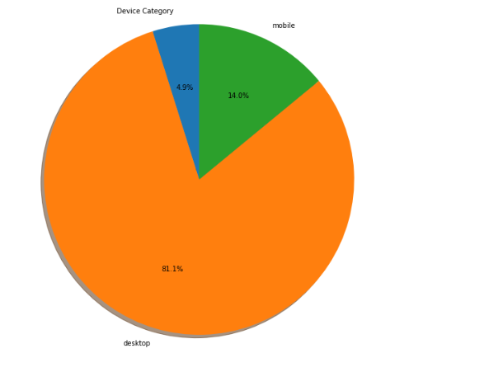
Univariate Analysis
Device Frequency
80% of the Traffic is from Desktops

Slide 3
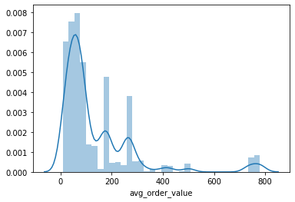
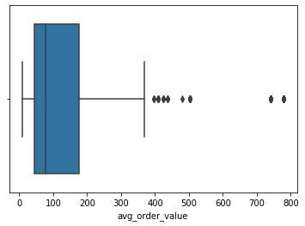
Avg Order Value
Historgram
Boxplot
75% of Traffic have Order value < $200 for Order value >0. Middle 50% of Traffic between Order Value 50$ and 200$

Slide 4
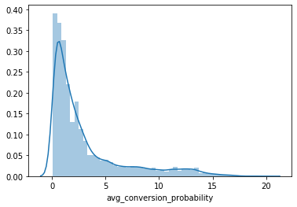
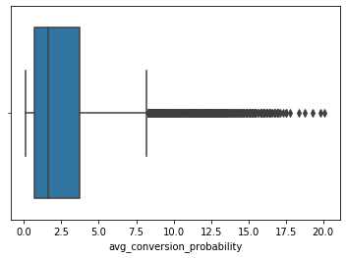
Avg. Conversion Probability
Historgram
Boxplot
75% of Traffic have Conversion Probability < 4% . Middle 50% of Traffic have conversion probability between 1 and 4

Slide 5
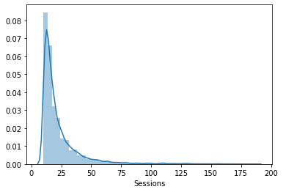
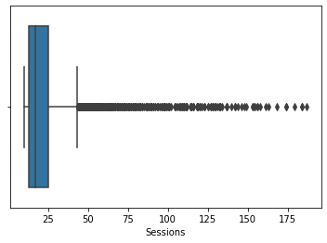
Avg #Sessions
75% of Traffic have # Sessions< 25. Middle 50% of Traffic have #Sessions between 15 and 25

Slide 6
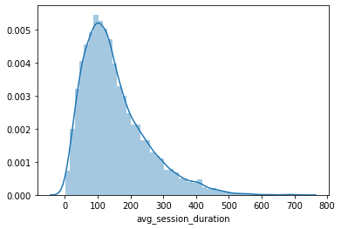
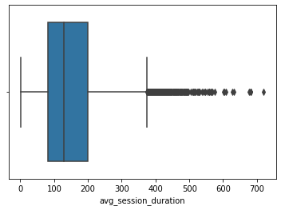
Avg Session Duration
75% of Traffic have # Avg Session Duration< 200 seconds. Middle 50% of Traffic have # Avg Session Duration between 70 and 200 seconds

Slide 7
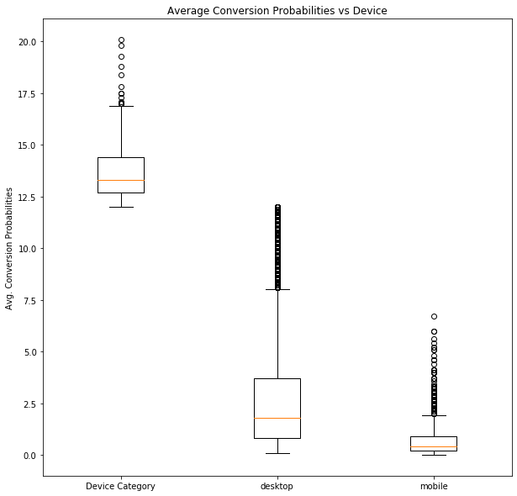
Avg. Conversion Probability vs device
Median Conversion Rate higher on ‘other devices’- This may be due to the Small Sample Size
Median Conversion Rate is Higher on Desktops than Mobile

Slide 8
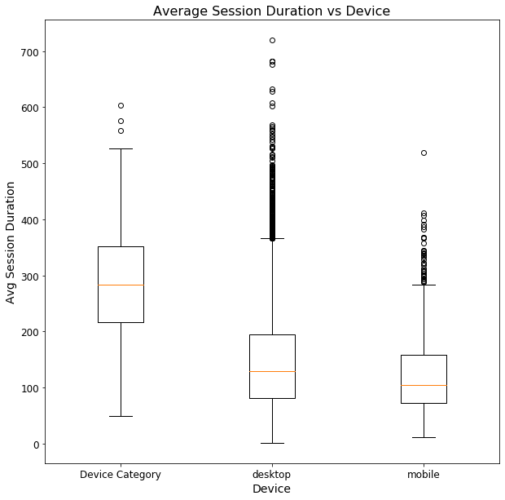
Average Session Duration vs Device
Other Devices have a higher median session duration
The Median 1st and 3rd Quartile Session Duration is Much higher on Desktops than Mobile

Slide 9
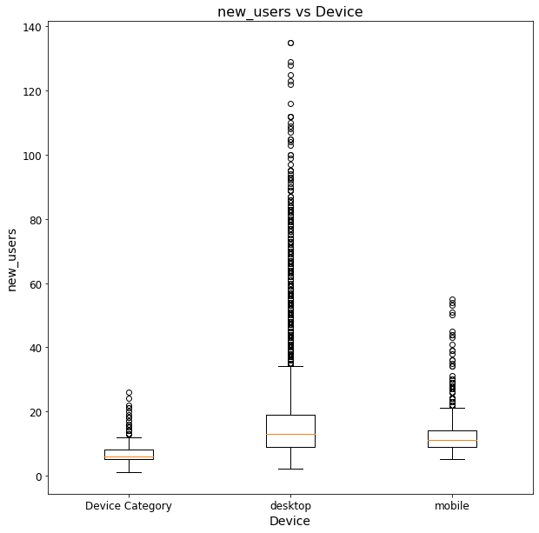
New Users vs Device
Median Number of New Users is much higher on Desktops than Mobile
Most New users use Desktop While visiting the site/medium

Slide 10
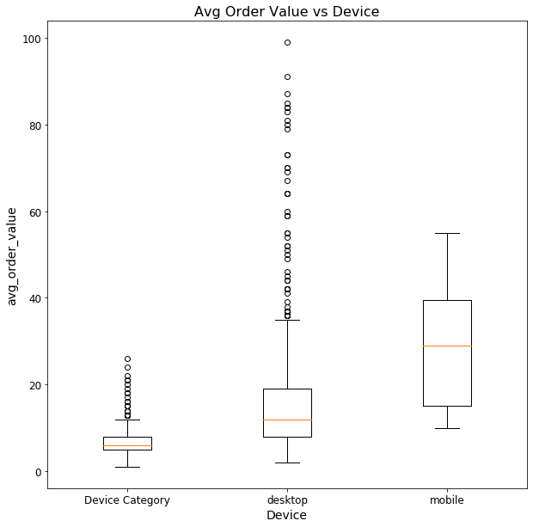
Avg Order Value vs Device
Median, 1st Quartile and 3rd Quartile Order Value much higher on Mobile than Desktop

Slide 11
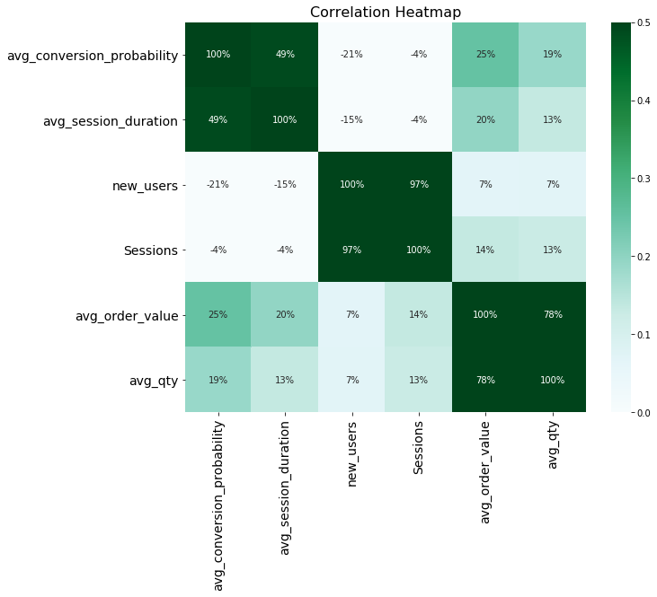
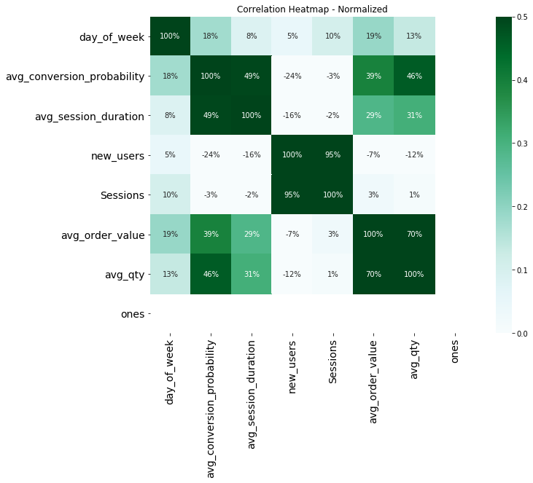
Correlation Matrix- Continuous Variables
Average Session Duration biggest Determinant of Conversion Probability. New Users are Negatively correlated with conversion Probability. The Correlation between New Users and Avg_order_value and avg_qty is low. # Sessions is Highly correlated with new users

Slide 12
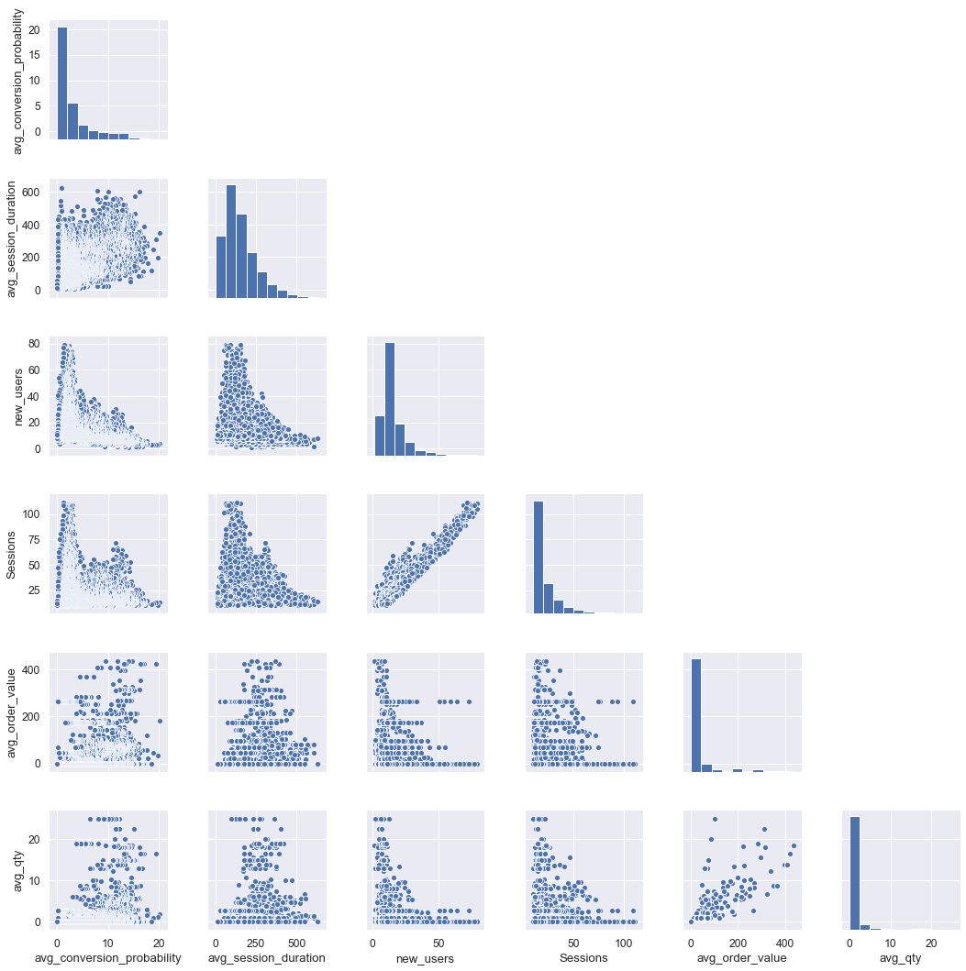
Continuous Variable Plots

Slide 13
Insights from Exploratory Data Analysis
Desktop Most Important device for New Users- Most New Users come to the website via Desktop
Most Old Users (Not New) Use Mobile Devices. Mobile Devices are Correlated with High Order values. Mobile Devices are Important for retaining users who are Old
Average Session Duration is highly correlated with conversion rate. A high Conversion Rate may cause a high Session duration due to time taken for Payment, etc.
New users are negatively correlated with conversion – implying that New users are unlikely to buy
Low Correlation between new users and Average Order Value and Average Qty. Implying that new users are unlikely to make large orders.
Median Conversion Probability is Higher on Desktops than on Mobile.

Slide 14
Top 3 Insights
Desktop Most Important device for New Users- Most New Users come to the website via Desktop
Most Old Users (Not New) Use Mobile Devices. Mobile Devices are Correlated with High Order values. Mobile Devices are Important for retaining users who are Old
Average Session Duration is highly correlated with conversion rate. A high Conversion Rate may cause a high Session duration due to time taken for Payment, etc. or it may imply that retaining users on the website for a long time increases conversion probability. The Joint Distribution of Conversion Probability and Session Duration is well dispersed away from the Mean- suggesting that a Large Session Duration cause a high conversion probability

Slide 15
Assumptions
High Order Values are associated with old users. The Basis for this is that The correlation between New User and Average Order value and avg qty is only 7%

